Slide 1
SC-900T00-A Module 4: Describe the Capabilities of Microsoft Compliance Solutions

Slide 2
Module Agenda
Describe the compliance management capabilities in Microsoft
Describe information protection and governance capabilities of
Microsoft 365
Describe insider risk capabilities in Microsoft 365
Describe eDiscovery, & audit capabilities in Microsoft 365
Describe resource governance capabilities in Azure

Slide 3
Lesson 1: Describe the compliance management capabilities in Microsoft

Slide 4
Lesson 1 Introduction
After completing this module, you should be able to:
Describe the benefit of the Service Trust Portal.
Describe Microsoft’s privacy principles.
Explore the Microsoft 365 compliance center.
Describe the benefits of Compliance Manager.
Notes:
Organizations must stay in line with compliance-related legal and regulatory standards to protect their customers, partners, and themselves. Microsoft provides tools and capabilities to enable organizations to manage compliance.
In this module, you’ll learn about the common compliance needs organizations are required to meet. You’ll also explore solutions like the Microsoft 365 compliance center and the Compliance Manager, which can help manage and simplify compliance across an organization.

Slide 5
Common compliance needs
Several measures to protect data:
Granting individuals the right to access their data at any time.
Granting individuals the right to correct or delete data about them if needed.
Introducing minimum or maximum retention periods for data.
Enabling governments and regulatory agencies the right to access and examine data when necessary.
Defining rules for what data can be processed and how that should be done.

Slide 6
Service Trust Portal
The Service Trust Portal provides:
Information
Tools
Other resources about Microsoft security, privacy, and compliance practices.
You can access below offerings:
Service Trust Portal
Compliance Manager
Trust Documents
Industries & Regions
Trust Center
Resources
My Library
Notes:
The Service Trust Portal provides information, tools, and other resources about Microsoft security, privacy, and compliance practices. Sign in with your Microsoft cloud services account to access all the available documentation.
From the main menu, you access:
Service Trust Portal – home page.
Compliance Manager – measures your progress in completing actions that help reduce risks around data protection and regulatory standards. To find out more, see the Microsoft Compliance Manager documentation in the Learn More section below.
Trust Documents – links to a security implementation and design information.
Industries & Regions – contains compliance information about Microsoft Cloud services organized by industry and region. The Industry Solutions link currently displays the home page for Financial Services. The Regional Solutions links currently have information for: Australia, Canada, Czech Republic, Denmark, Germany, Poland, Romania, Spain, and the United Kingdom.
Trust Center – links to the Microsoft Trust Center, which provides more information about security, compliance, and privacy in the Microsoft Cloud.
Resources – links to resources including information about the features and tools available for data governance and protection in Office 365, the Microsoft Global Datacenters, and Frequently Asked Questions.
My Library – allows you to add documents and resources that are relevant to your organization. Everything is in one place. You can also opt to have email notifications sent when a document is updated, and set the frequency you receive notifications.

Slide 7
Microsoft's privacy principles
Control: Putting you, the customer, in control of your privacy with easy-to-use tools and clear choices.
Transparency: Being transparent about data collection and use so that everyone can make informed decisions.
Security: Protecting the data that's entrusted to Microsoft by using strong security and encryption.
Strong legal protections: Respecting local privacy laws and fighting for legal protection of privacy as a fundamental human right.
No content-based targeting: Not using email, chat, files, or other personal content to target advertising.
Benefits to you: When Microsoft does collect data, it's used to benefit you, the customer, and to make your experiences better.

Slide 8
Demo
Service Trust Portal
Notes:
Refer to script in demos word documents.

Slide 9
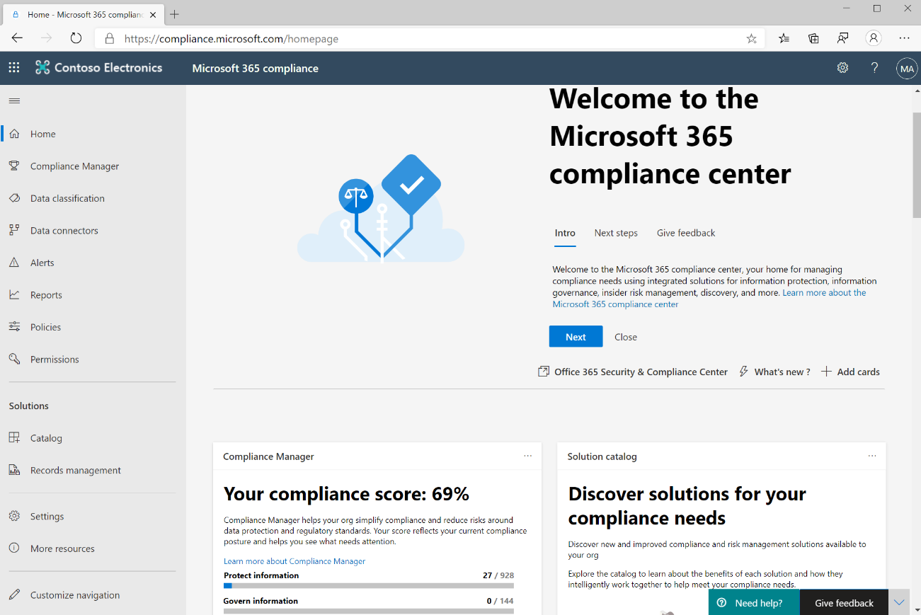
Microsoft 365 Compliance Center
Microsoft 365 Compliance center portal
A view of how the organization is meeting its compliance requirements
Solutions that can be used to help with compliance
Information about active alerts
And more…
Navigation
Access to alerts, reports, policies, compliance solutions, and more.
Add or remove options for a customized navigation pane.
Customize navigation control.
Notes:
The Microsoft 365 compliance center brings together all of the tools and data that are needed to help understand and manage an organization’s compliance needs.
Compliance center is available to customers with a Microsoft 365 SKU with one of the following roles:
Global administrator
Compliance administrator
Compliance data administrator
The compliance score card. This card shows the compliance score, and will forward admins to the Compliance Manager where they can see a breakdown of the compliance score. Compliance score measures the progress in completing recommended improvement actions within controls. The score helps an organization to understand its current compliance posture. It also helps an organization to prioritize actions based on their potential to reduce risk.
The new Solution catalog card, links to collections of integrated solutions that are used to manage end-to-end compliance scenarios across three compliance solutions areas:
The Information protection & governance section quickly shows you how to use Microsoft 365 compliance solutions to protect and govern data in your organization.
The Insider risk management section on the home page shows how your organization can identify, analyze, and act on internal risks before they cause harm.
The Discovery & respond section on the home page shows how your organization can quickly find, investigate, and respond to compliance issues with relevant data.
The Active alerts card includes a summary of the most active alerts and a link where admins can view more detailed information, such as alert severity, status, category, and more.

Slide 10
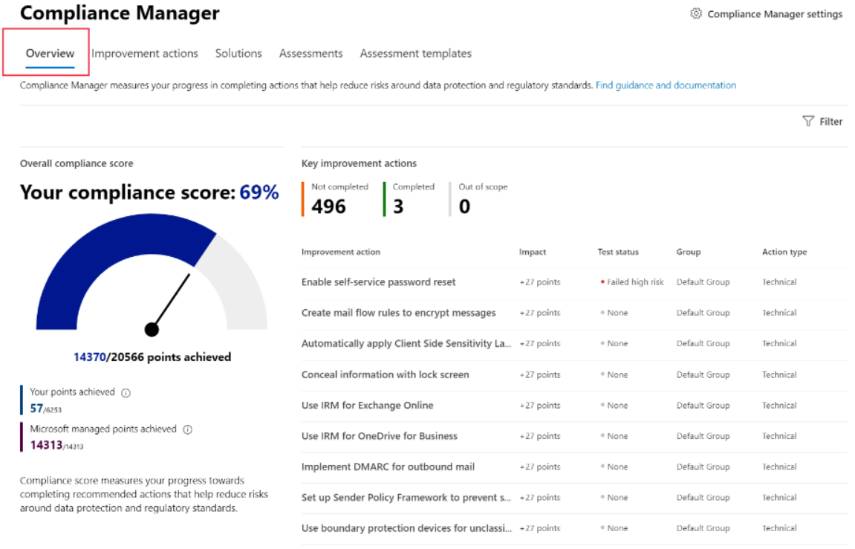
Compliance Manager
Compliance Manager simplifies compliance and reduces risk by providing:
Prebuilt assessments based on common standards
Workflow capabilities to complete risk assessments
Step-by-step improvement actions
Compliance score, shows overall compliance posture
Key elements of Compliance Manager
Controls
Assessments
Templates
Improvement actions
Notes:
Microsoft Compliance Manager is a feature in the Microsoft 365 compliance center that helps admins to manage an organization’s compliance requirements with greater ease and convenience. Compliance Manager can help organizations throughout their compliance journey, from taking inventory of data protection risks, to managing the complexities of implementing controls, staying current with regulations and certifications, and reporting to auditors.
The following video provides a quick overview of Compliance Manager:
https://www.microsoft.com/en-us/videoplayer/embed/RE4FGYZ
Compliance Manager helps simplify compliance and reduce risk by providing:
Prebuilt assessments based on common regional and industry regulations and standards. Admins can also use custom assessment to help with compliance needs unique to the organization.
Workflow capabilities that enable admins to efficiently complete risk assessments for the organization.
Step-by-step improvement actions that admins can take to help meet regulations and standards relevant to the organization. Some actions will also be managed for the organization by Microsoft. Admins will get implementation details and audit results for those actions.
Compliance score, which is a calculation that helps an organization understand its overall compliance posture by measuring how it's progressing with improvement actions.
Controls
A control is a requirement of a regulation, standard, or policy. It defines how to assess and manage system configuration, organizational process, and people responsible for meeting a specific requirement of a regulation, standard, or policy.
Compliance Manager tracks the following types of controls:
Microsoft-managed controls: controls for Microsoft cloud services, which Microsoft is responsible for implementing.
Your controls: sometimes referred to as customer-managed controls, these are implemented and managed by the organization.
Shared controls: responsibility for implementing these controls is shared by the organization and Microsoft.
Assessments
An assessment is a grouping of controls from a specific regulation, standard, or policy. Completing the actions within an assessment helps to meet the requirements of a standard, regulation, or law. For example, an organization may have an assessment that, when the admin completes all actions within it, it helps to bring the organization’s Microsoft 365 settings in line with ISO 27001 requirements.
Assessments have several components:
In-scope services: the specific set of Microsoft services applicable to the assessment.
Microsoft-managed controls: controls for Microsoft cloud services, which Microsoft implements for the organization.
Your controls: these controls, sometimes referred to as customer-managed controls, are implemented and managed by the organization.
Shared controls: responsibility for implementing these controls is shared by the organization and Microsoft.
Assessment score: shows the progress in achieving total possible points from actions within the assessment that are managed by the organization and by Microsoft.
Templates
Compliance Manager provides templates to help admins to quickly create assessments. They can modify these templates to create an assessment optimized for their needs. Admins can also build a custom assessment by creating a template with their own controls and actions. For example, the admin may want a template to cover an internal business process control, or a regional data protection standard that isn’t covered by one of Microsoft’s 150-plus prebuilt assessment templates.
Improvement actions
Improvement actions help centralize compliance activities. Each improvement action provides recommended guidance that's intended to help organizations to align with data protection regulations and standards. Improvement actions can be assigned to users in the organization to do implementation and testing work. Admins can also store documentation, notes, and record status updates within the improvement action.

Slide 11
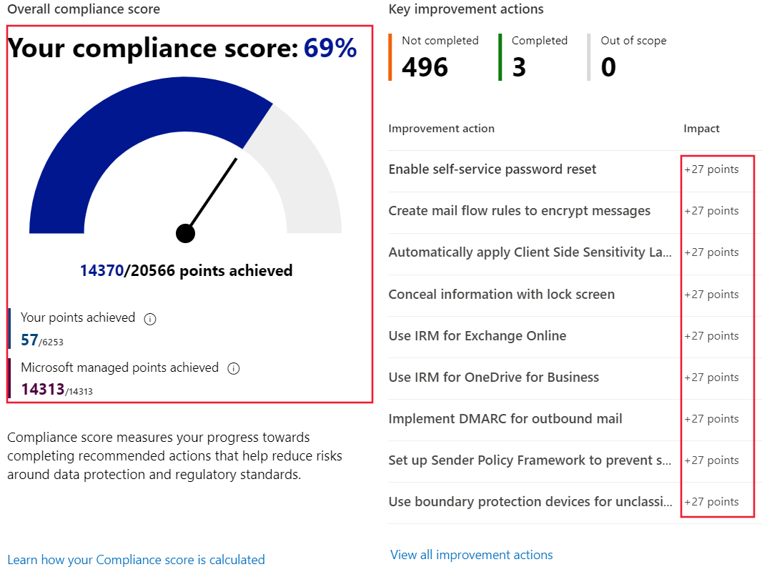
Compliance score
Benefits of compliance score:
Help an organization understand its current compliance posture.
Help prioritize actions based on their potential to reduce risk.
Understand your compliance score
Actions
Your improved actions
Microsoft actions
Action types ( & action subcategory)
Mandatory (preventive, detective, or corrective)
Discretionary (preventive, detective, or corrective)
Notes:
Compliance score measures progress in completing recommended improvement actions within controls. The score can help an organization to understand its current compliance posture. It also helps organizations to prioritize actions based on their potential to reduce risk.
What is the difference between Compliance Manager and compliance score?
Compliance Manager is an end-to-end solution in Microsoft 365 compliance center to enable admins to manage and track compliance activities. Compliance score is a calculation of the overall compliance posture across the organization. The compliance score is available through Compliance Manager.
Compliance Manager gives admins the capabilities to understand and increase their compliance score, so they can ultimately improve the organization’s compliance posture and help it to stay in line with compliance requirements.
How to understand the compliance score
The overall compliance score is calculated using scores that are assigned to actions. Actions come in two types:
Your improved actions: actions that the organization is expected to manage.
Microsoft actions: actions that Microsoft manages for the organization.
These action types have points assigned to them that count towards the compliance score. Actions can also be considered technical or nontechnical, which also affects how they impact the overall compliance score. Actions are also assigned a score value based on whether they’re categorized as mandatory, discretionary, preventative, detective, or corrective:
Mandatory – these actions shouldn’t be bypassed. For example, creating a policy to set requirements for password length or expiration.
Discretionary – these actions depend on the users understanding and adhering to a policy. For example, a policy where users are required to ensure their devices are locked before they leave them.
The following are subcategories of actions that can be classified as mandatory or discretionary:
Preventative actions are designed to handle specific risks, like using encryption to protect data at rest if there were breaches or attacks.
Detective actions actively monitor systems to identify irregularities that could represent risks, or that can be used to detect breaches or intrusions. Examples of these types of actions are system access audits, or regulatory compliance audits.
Corrective actions help admins to minimize the adverse effects of security incidents, by undertaking corrective measures to reduce their immediate effect or possibly even reverse damage.
Actions that are mandatory and preventative, with 27 points, provide the highest points value towards your compliance score. Organizations accumulate points for every action completed. And the compliance score is shown as a percentage representing all the actions completed, compared with the ones outstanding:

Slide 12
Demo
Microsoft 365 Compliance Center
Notes:
Refer to demo script in GitHub
.

Slide 13
Lesson 2: Describe information protection and governance capabilities of Microsoft 365

Slide 14
Lesson 2 Introduction
After completing this module, you should be able to:
Describe data classification capabilities.
Describe records management.
Describe data loss prevention.
Notes:
Organizations need to protect all sorts of information, including financial and personal information. This must be done to ensure customers, employees, and the organization are protected from risks. The organization needs to stay in line with compliance standards wherever it operates.
Microsoft provides solutions that can help organizations to implement information protection and governance.
In this module, you’ll learn about how Microsoft solutions and capabilities like data classification, records management, and data loss prevention, can help you implement information protection and governance.

Slide 15
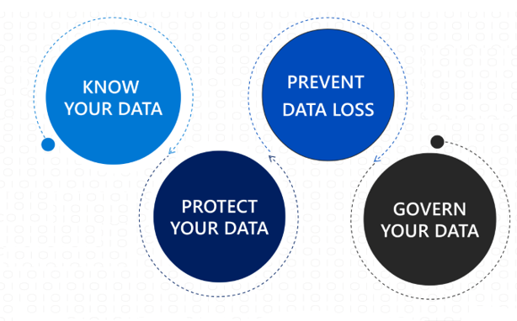
Know your data, protect your data, and govern your data
Know your data: Understand your data landscape and identify important data across on-premises, cloud, and hybrid environments.
Protect your data: Apply flexible protection actions including encryption, access restrictions, and visual markings.
Prevent data loss: Detect risky behavior and prevent accidental oversharing of sensitive information.
Govern your data: Automatically keep, delete, and store data and records in a compliant manner.
Notes:
Microsoft Information Protection (MIP) discovers, classifies, and protects sensitive and business-critical content throughout its lifecycle across your organization. It provides the tools to know your data, protect your data, and prevent data loss.
Microsoft Information Governance (MIG) manages your content lifecycle using solutions to import, store, and classify business-critical data so you can keep what you need and delete what you don't. It gives organizations the capabilities to govern their data, for compliance or regulatory requirements. Microsoft Information Protection and Microsoft Information Governance work together to classify, protect, and keep your data where it lives, and wherever it goes.
Know your data: Organizations can understand their data landscape and identify important data across on-premises, cloud, and hybrid environments. Capabilities and tools such as trainable classifiers (preview), activity explorer, and content explorer allow organizations to know their data.
Protect your data: Organizations can apply flexible protection actions including encryption, access restrictions, and visual markings.
Prevent data loss: Organizations can detect risky behavior and prevent accidental oversharing of sensitive information. Capabilities such as data loss prevention policies and endpoint data loss prevention enable organizations to avoid data loss.
Govern your data: Organizations can automatically keep, delete, and store data and records in a compliant manner. Capabilities like retention policies, retention labels, and records management enable organizations to govern their data.

Slide 16
Data classification capabilities in the Microsoft 365 Compliance Center
Sensitive information types.
Trainable classifiers: Pre-trained classifiers and Custom trainable classifiers.
Understand and explore the data.
The content explorer: It enables administrators to gain visibility into the content that has been summarized in the overview pane.
The activity explorer: It can monitor what's being done with labeled content across the organization.
Notes:
Sensitive information types
Examples include:
Credit card numbers
Passport or identification numbers
Bank account numbers
Health service numbers
Trainable classifiers
Pre-trained classifiers - Microsoft has created and pretrained many classifiers that you can start using without training them. These classifiers will appear with the status of Ready to use. Microsoft 365 comes with five pretrained classifiers that detect and classify things like resumes, source code, harassment, profanity, and threat (relates to committing violence or doing physical harm).
Custom trainable classifiers - Microsoft supports the ability to create and train custom classifiers. They're most useful when classifying data unique to an organization, like specific kinds of contracts, invoices, or customer records.
Understand and explore the data
The number of items classified as sensitive information and which classifications they are.
Details on the locations of data based on sensitivity.
Summary of actions that users are taking on sensitive content across the organization.
What is the content explorer?
The content explorer is available as a tab in the data classification pane of compliance center. It enables administrators to gain visibility into the content that has been summarized in the overview pane. Access to content explorer is highly restricted because it makes it possible to read the contents of scanned files. There are two roles that grant access to content explorer:
Content explorer list viewer.
Content explorer content viewer.
What is the activity explorer?
Activity explorer provides visibility into what content has been discovered and labeled, and where that content is. It makes it possible to monitor what's being done with labeled content across the organization. Admins gain visibility into document-level activities like label changes and label downgrades (such as when someone changes a label from confidential to public).
Admins use the filters to see all the details for a specific label, including file types, users, and activities. Activity explorer helps you understand what's being done with labeled content over time. Admins use activity explorer to evaluate if controls already in place are effective.

Slide 17
Sensitivity labels and policies
Sensitivity labels
Labels are:
Customizable
Clear text
Persistent
Usage:
Encrypt email and documents.
Mark the content.
Apply the label automatically.
Protect content in containers: sites and groups.
Extend sensitivity labels to third-party apps and services.
Classify content without using any protection settings.
Label policies
Policies enable admins to:
Choose the users and groups that can see labels
Apply a default label to all new emails and documents
Require justifications for label changes
Require users to apply a label (mandatory labeling)
Link users to custom help pages
Once a sensitivity label is applied to an email or document, any configured protection settings for that label are enforced on the content.
Notes:
Sensitivity labels
Sensitivity labels, available as part of information protection in the Microsoft 365 compliance center, enable the labeling and protection of content, without affecting productivity and collaboration. With sensitivity labels, organizations can decide on labels to apply to content such as emails and documents, much like different stamps are applied to physical documents:
Labels are:
Customizable: Admins can create different categories specific to the organization, such as Personal, Public, Confidential, and Highly Confidential.
Clear text: Because each label is stored in clear text in the content's metadata, third-party apps and services can read it and then apply their own protective actions, if necessary.
Persistent. After you apply a sensitivity label to content, the label is stored in the metadata of that email or document. The label then moves with the content, including the protection settings, and this data becomes the basis for applying and enforcing policies.
Each item that supports sensitivity labels can only have one applied to it
Sensitivity labels can be used to:
Encrypt email only or both email and documents. When a document or email is encrypted, access to the content is restricted, so that:
It can be decrypted only by users authorized by the label's encryption settings.
Remains encrypted no matter where it stays, inside or outside your organization, even if the file is renamed.
It's encrypted both at rest (for example, in a OneDrive account) and in transit (for example, an email message as it traverses the internet).
Mark the content when Office apps are used. Marking the content includes adding watermarks, headers, or footers. Headers or footers can be added to emails or documents that have the label applied. Watermarks can be applied to documents but not to email.
Apply the label automatically in Office apps or recommend a label. Admins choose the types of sensitive information to be labeled. The label can be applied automatically or configured to prompt users to apply the recommended label.
Protect content in containers such as sites and groups when this capability is enabled. This label configuration doesn't result in documents being automatically labeled. Instead, the label settings protect content by controlling access to the container where documents are stored.
Extend sensitivity labels to third-party apps and services. Using the Microsoft Information Protection SDK, third-party apps can read sensitivity labels and apply protection settings.
Classify content without using any protection settings. A classification can be assigned to content (just like a sticker) that persists and roams with the content as it's used and shared. The classification can be used to generate usage reports and view activity data for sensitive content.
Label policies
After sensitivity labels are created, they need to be published to make them available to people and services in the organization. Sensitivity labels are published to users or groups through label policies. Sensitivity labels will then appear in Office apps for those users and groups. The sensitivity labels can be applied to documents and emails. Label policies enable admins to:
Choose the users and groups that can see labels. Labels can be published to specific users, distribution groups, Microsoft 365 groups in Azure Active Directory, and more.
Apply a default label to all new emails and documents that the specified users and groups create. Users can always change the default label if they believe the document or email has been mislabeled.
Require justifications for label changes. If a user wants to remove a label or replace it, admins can require the user to provide a valid justification to complete the action. The user will be prompted to provide an explanation for why the label should be changed.
Require users to apply a label (mandatory labeling). It ensures a label is applied before users can save their documents, send emails, or create new sites or groups.
Link users to custom help pages. It helps users to understand what the different labels mean and how they should be used.
Once a sensitivity label is applied to an email or document, any configured protection settings for that label are enforced on the content. For example, by choosing encryption settings for a sensitivity label, admins can protect content so that:
Only users within the organization can open a confidential document or email.
Only users in a specific department can edit and print a document or email, while all other users in the organization can only read it.
Users can't forward or copy information from an email.
Users can't open a document after a specified date.

Slide 18
Demo
Sensitivity labels
Notes:
Refer to demo script in GitHub

Slide 19
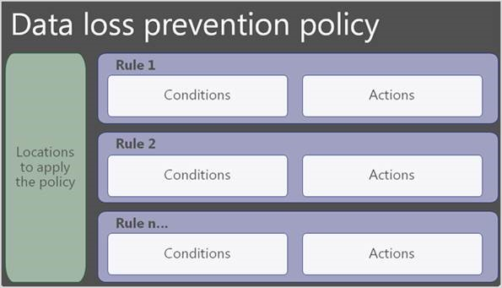
Describe data loss prevention (DLP)
DLP protects sensitive information and prevents its inadvertent disclosure.
DPL policies protect information by identifying and automatically protecting sensitive data.
Protect sensitive information across Microsoft 365 – OneDrive for Business, SharePoint Online, Exchange Online and Microsoft Teams
Endpoint Data Loss Prevention
DLP extended to Windows 10 devices.
Audit and manage activities including creating, coping, printing, & renaming items
Data Loss Prevention in Microsoft Teams
DPL capabilities extended to Microsoft Teams chat and channel message.
Notes:
With DLP policies, admins can:
Identify, monitor, and automatically protect sensitive information across Microsoft 365, including:
OneDrive for Business
SharePoint Online
Microsoft Teams
Exchange Online
Help users learn how compliance works without interrupting their workflow. For example, if a user tries to share a document containing sensitive information, a DLP policy can send them an email notification and show them a policy tip.
View DLP reports showing content that matches the organization's DLP policies. To assess how the organization is following a DLP policy, admins can see how many matches each policy has over time.
DLP policies protect content through the enforcement of rules that consist of:
Conditions that the content must match before the rule is enforced.
Actions that the admin wants the rule to take automatically when content that matches the conditions has been found.
Locations where the policy will be applied, such as Exchange, SharePoint, OneDrive, and more.
DLP policies protect information by identifying and automatically protecting sensitive data. Here's some scenarios where DLP policies can help:
Identify any document containing a credit card number stored in users’ OneDrive for Business accounts.
Automatically block an email containing employee personal information from being sent outside the organization.
What is endpoint data loss prevention?
Endpoint data loss prevention is how the protection and activity monitoring capabilities of DLP for sensitive content can be extended to Windows 10 devices. Admins can choose to target Windows 10 when creating a DLP policy (after onboarding the devices to Microsoft 365 compliance solutions). Endpoint DLP enables admins to audit and manage activities that users complete on sensitive content, including:
Creating an item
Renaming an item
Copying items to removable media
Copying items to network shares
Printing documents
Accessing items using unallowed apps and browsers
In the activity explorer, you can view information about what users are doing with sensitive content:
Data loss prevention in Microsoft Teams
Data loss prevention capabilities have been extended to Microsoft Teams chat and channel messages, including messages in private channels. With DLP, administrators can now define policies that prevent users from sharing sensitive information in a Teams chat session or channel, whether it's in a message, or a file. Just like with Exchange, Outlook, SharePoint, and OneDrive for Business, administrators can use DLP policy tips that will be displayed to the user to show them why a policy has been triggered.
With DLP policies, Microsoft Teams can help users across organizations to collaborate securely and in a way that's in line with compliance requirements.

Slide 20
Retention polices and labels
Retention settings work with SharePoint, OneDrive, Teams, Yammer and Exchange and help organizations manage and govern information by ensuring content is kept only for a required time, and then permanently deleted.
Retention policies:
Are applied at site or mailbox level,
Can be applied to multiple locations or specific locations or users.
Items inherit the retention settings from their container.
If an item is moved, the retention setting does not travel to the new location.
Retention labels:
Are applied at an item level.
Emails and documents can have only a single retention label assigned to it at a time.
Retention settings from retention labels travel with the content in your Microsoft 365 tenant.
Can be applied manually or automatically.
Retention labels support disposition review of the content before it's permanently deleted.
Notes:
Retention labels and policies help organizations to manage and govern information by ensuring content is kept only for a required time, and then permanently deleted. Applying retention labels and assigning retention policies helps organizations:
Comply proactively with industry regulations and internal policies that require content to be kept for a minimum time.
Reduce risk when there's litigation or a security breach by permanently deleting old content that the organization is no longer required to keep.
Ensure users work only with content that's current and relevant to them. When content has retention settings assigned to it, that content remains in its original location. People can continue to work with their documents or mail as if nothing's changed. But if they edit or delete content that's included in the retention policy, a copy of the content is automatically kept in a secure location. The secure locations and the content are not visible to most people. In most cases, people don't even need to know that their content is subject to retention settings.
When content has retention settings assigned, it stays in its original location. People can continue to work with their documents or mail as if nothing's changed. But if they edit or delete content that's included in the retention policy, a copy is automatically kept in a secure location. The secure locations and the retained content aren't visible to most people. In most cases, people don't even need to know that their content is subject to retention settings.
Retention settings work with the following different workloads:
SharePoint and OneDrive
Microsoft Teams
Yammer
Exchange
When using retention policies and retention labels to assign retention settings to content, there are some points to understand about each. Listed below are just a few of the key points. For a more complete list visit Compare capabilities for retention policies and retention labels.

Slide 21
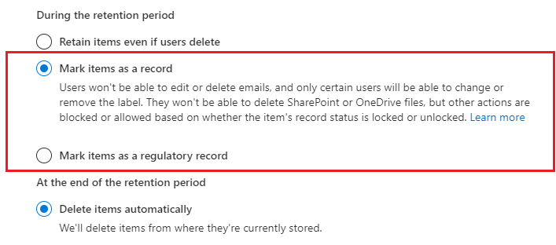
Records management
Records management in Microsoft 365 helps an organization look after their legal obligations and helps to demonstrate compliance with regulations.
When content is labeled as a record, the following happens:
Restrictions are put in place to block certain activities.
Activities are logged.
Proof of disposition is kept at the end of the retention period.
To enable items to be marked as records, an administrator sets up retention labels.
Notes:
Organizations of all types require a management solution to manage regulatory, legal, and business-critical records across their corporate data. Records management in Microsoft 365 helps an organization look after their legal obligations. It also helps to demonstrate compliance with regulations, and increases efficiency with regular disposition of items that are no longer required to be kept, no longer of value, or no longer required for business purposes. It provides the following capabilities:
Labeling content as a record.
Migrating and managing retention plans with file plan manager.
Establishing retention and deletion policies within the record label.
Triggering event-based retention.
Reviewing and validating disposition.
Proof of records deletion.
Exporting information about disposed items.
Setting specific permissions for record manager functions in the organization.
When content is labeled as a record, the following happens:
Restrictions are put in place to block certain activities.
Activities are logged.
Proof of disposition is kept at the end of the retention period.
To enable items to be marked as records, an administrator sets up retention labels.
Items such as documents and emails can then be marked as records based on those retention labels. Items might be marked as records, but they can also be shown as regulatory records. Regulatory records provide other controls and restrictions such as:
A regulatory label can’t be removed when an item has been marked as a regulatory record.
The retention periods can’t be made shorter after the label has been applied.
For more information on comparing, use the Compare restrictions for what actions are allowed or blocked section of the documentation.
The most important difference is that if content has been marked as a regulatory record, nobody, not even a global administrator, can remove the label. Marking an item as a regulatory record can have irreversible consequences, and should only be used when necessary. As a result, this option isn’t available by default, and has to be enabled by the administrator using PowerShell.
Common use cases for records management
Microsoft 365’s records management capabilities are flexible. There are different ways in which records management can be used across an organization, including:
Enabling administrators and users to manually apply retention and deletion actions for documents and emails.
Automatically applying retention and deletion actions to documents and emails.
Enabling site admins to set default retain and delete actions for all content in a SharePoint library, folder, or document set.
Enabling users to automatically apply retain and delete actions to emails by using Outlook rules.

Slide 22
Lesson 3: Describe insider risk capabilities in Microsoft 365

Slide 23
Lesson 3 Introduction
After completing this module, you should be able to:
Describe how Microsoft 365 can help organizations identify insider risks and take appropriate action.
Notes:
Organizations understand that risks can come from insiders, like contractors, or even employees. There's always a risk that people might share information with competitors after leaving the company. Organizations need to ensure that they’re protected from these kinds of risks.
In this module, you’ll learn how Microsoft 365 capabilities like insider risk management, communication compliance, information barriers, privileged access management, and Customer Lockbox can help you protect your organization.

Slide 24
Insider risk solutions in Microsoft 365 (Slide 1)
Insider risk management helps minimize internal risks by enabling you to detect, investigate, and act on malicious and inadvertent activities in your organization.
Communication compliance helps minimize communication risks by helping you detect, capture, and act on inappropriate messages in your organization. Supported services: Microsoft Teams, Exchange Online, Yammer, & 3rd party communications in an org.
Information barriers allow you to restrict communication and collaboration between two internal groups to avoid a conflict of interest from occurring in your organization. Supported in Microsoft Teams, OneDrive for Business, SharePoint Online, and more.
Notes:
Insider risk management helps detect, investigate, and take action to mitigate internal risks in your organization from scenarios, including data theft by employees, the intentional, or unintentional leak of confidential information, offensive behavior, and more.
Workflow:
Insider risk management policies are created.
Alerts are automatically generated by risk indicators that match policy conditions.
As part of the triage process, reviewers can view alert details for the policy match.
Cases are created for alerts that require investigation into details of the policy match.
After cases are investigated, reviewers take action to resolve the case.
Communication compliance helps minimize communication risks by enabling organizations to detect, capture, and take remediation actions for inappropriate messages.
Supported services:
Microsoft Teams
Exchange Online
Yammer
third-party communications in an organization
Workflow:
Configure applicable communication compliance policies.
Investigate the issues detected when matching communication compliance policies.
Remediate communications compliance issues.
Monitor issues identified by communication compliance policies, throughout the workflow.
Information barriers are policies that admins can configure to prevent individuals or groups from communicating with each other.
Only support two-way restrictions
Supported in Microsoft Teams, OneDrive for Business, SharePoint Online, and more.
Information barriers In Teams, identifies and prevents the following kinds of unauthorized communications:
Searching for a user,
Adding a member to a team
Chat session, group chat
Inviting someone to join a meeting
Sharing a screen, placing a call
Sharing a file with another user
Access to file through sharing link

Slide 25
Insider risk solutions in Microsoft 365 (Slide 2)
Privileged access management allows granular access control over privileged Exchange Online admin tasks in Office 365.
Customer Lockbox ensures that Microsoft cannot access customer content to perform a service operation without the customer’s explicit approval. Supported services: Exchange Online, SharePoint Online, OneDrive for Business.
Notes:
Privileged Access Management
Allow granular access control over privileged admin tasks in Microsoft 365.
Require just-in-time access to complete elevated tasks through a highly scoped and time-bound approval workflow
Help protect organizations from breaches that use existing privileged admin accounts.
Workflow
Configure a privileged access policy
Access request
Access approval
Access processing
Customer Lockbox ensures that Microsoft can't access customer content to perform a service operation without explicit approval from the customer.
Supported services:
Exchange Online
OneDrive for Business
SharePoint Online

Slide 26
Lesson 4: Describe eDiscovery & Audit capabilities in Microsoft 365

Slide 27
Lesson 4 Introduction
After completing this module, you should be able to:
Describe the purpose of eDiscovery & the capabilities of the content search tool.
Describe the core & advanced eDiscovery workflows.
Describe the core and advanced audit capabilities of Microsoft 365.

Slide 28
eDiscovery & content search
Purpose of eDiscovery
Find electronic information to be used as evidence when a company is involved in litigation..
Search for content in Exchange Online mailboxes, Microsoft 365 Groups, Microsoft Teams, SharePoint Online and OneDrive for Business sites, Skype for Business conversations, and Yammer teams.
Use to identify, hold, and export content found in mailboxes and sites.
Content Search
Search Exchange Online mailboxes, SharePoint Online sites, OneDrive for Business, Teams, Microsoft 365 groups, Yammer groups
Build search queries and use conditions
Create, report on, and delete multiple searches
View keyword statistics
Search for third-party data
PowerShell scripts for more complex search related tasks
Notes:
The Content Search eDiscovery tool, accessible from the compliance center in Office 365 or Microsoft 365, enables search for in-place items such as email, documents, and instant messaging conversations in your organization. Search for items is supported in the following services:
Exchange Online mailboxes and public folders
SharePoint Online sites and OneDrive for Business accounts
Skype for Business conversations
Microsoft Teams
Microsoft 365 Groups
Yammer Groups
To have access to the content search page to run searches and preview and export results, an administrator, compliance officer, or eDiscovery manager must be a member of the eDiscovery Manager role group in the Security and Compliance Center. For more information, visit Assign eDiscovery permissions.
To start using the Content Search tool, you must choose content locations to search and configure a keyword query to find specific items. Or the user can just leave the query blank and return all items in the target locations. Examples of some of the capabilities for running a search include:
Build search queries and use conditions to narrow your search.
Configure search permissions filtering so that an eDiscovery manager can only search for a subset of mailboxes or sites in your organization.
Run an ID list search to search for specific mailbox email messages and other mailbox items using a list of Exchange IDs.
Search for Teams chat data across on-premises users.
View keyword statistics for the results of a search and then refine the query if necessary.
Search for third-party data that your organization has imported to Microsoft 365.
Preserve Bcc recipients to follow regulatory compliance and eDiscovery requirements that may require organizations to preserve mailbox content, including the ability to search for and reproduce details about all recipients of a message, not just those on the "to" and "cc" list.
Complete actions on content
After you run a search and refine it as necessary, the next step is to do something with the results returned by the search. You can export and download the results to your local computer or, if there is an email-based attack, you can delete the results of a search from user mailboxes. You can also use scripts for advanced scenarios. Sometimes you have to do more advanced, complex, and repetitive content search tasks. To help make this easier, Microsoft has created a number of Security and Compliance Center PowerShell scripts to help complete complex content search-related tasks. Some of these scripts include:
Search-specific mailbox and site folders (called a targeted collection) when you're confident that items responsive to a case are located in that folder.
Search the mailbox and OneDrive location for a list of users.
Create, report on, and delete multiple searches to quickly and efficiently identify, and cull search data.
Clone a content search and quickly compare the results of different keyword search queries run on the same content locations; or use the script to save time by not having to reenter a large number of content locations when you create a new search.
Content Search is easy to use, but it's also a powerful tool. To learn more, visit the content search overview.

Slide 29
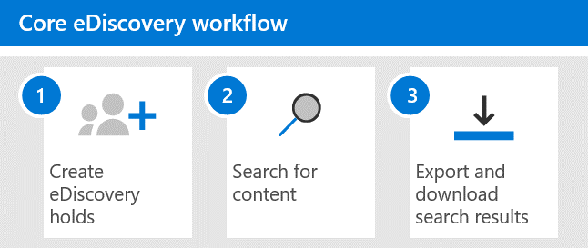
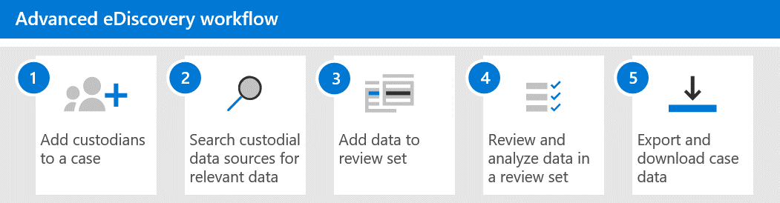
Core and advanced eDiscovery workflows
Core eDiscovery
Create a hold to preserve content that might be relevant to the case (mailboxes, sites, and public folders).
Create and run searches for content that relates to the case.
Export and download search results.
Advanced eDiscovery builds on core eDiscovery
Add persons of interest (custodians) and data sources that aren't associated with a specific user.
Use the built-in collections tool to search data sources for content relevant to the case.
Data added to a review set are copied from their original location to a secure Azure Storage location. The data is reindexed again to optimize for fast searches
Use a wide-variety of tools and capabilities to view and analyze the case data with goal of reducing the data set to what is most relevant to the case
Export and download case data

Slide 30
Audit capabilities of Microsoft 365
Core Audit
Allows organizations to view user and administrator activity.
An audited activity generates an audit record that is stored in the audit log.
Searching the audit log requires the search capability to be turned on and assigned the appropriate role.
The results can be filtered and exported to a CSV file.
Advanced Audit - Core Audit, plus:
Long-term retention of audit logs
High-bandwidth access to Office 365 Management Activity API
Access to crucial events for investigations
MailItemsAccessed
Send
SearchQueryInitiatedExchange
SearchQueryInitiatedSharePoint
Notes:
Core Audit:
Searching the audit log requires the search capability to be turned on, and for the user doing the search to be assigned the appropriate role. The search criteria can be configured based on:
Activities
Start date and end date
Users
File, folder, or site
The results of the audit log search, which can be filtered and exported to a CSV
Advanced Audit:
Long-term retention of audit logs - Advanced Audit keeps all Exchange, SharePoint, and Azure Active Directory audit records for one year. Keeping audit records for longer periods can help with ongoing forensic or compliance investigations. Microsoft is planning to release the capability to keep audit logs for 10 years. The 10-year retention of audit logs helps support long-running investigations and respond to regulatory, legal, and internal obligations.
Access to crucial events for investigations - Advanced Auditing helps organizations to conduct forensic and compliance investigations by providing access to crucial events, such as when mail items were accessed, when mail items were replied to and forwarded, and when and what a user searched for in Exchange Online and SharePoint Online. These crucial events can help admins and users investigate possible breaches and determine the scope of compromise.
Advanced Auditing provides the following crucial events:
MailItemsAccessed - The MailItemsAccessed event is a mailbox auditing action that's triggered when mail data is accessed by mail protocols and mail clients. The MailItemsAccessed action can help investigators identify data breaches and determine the scope of messages that may have been compromised.
Send - The Send event is also a mailbox auditing action and is triggered when a user does one of the following actions:
Sends an email message
Replies to an email message
Forwards an email message
Investigators can use the Send event to identify emails sent from a compromised account. The audit record for a Send event contains information about the message. The actual content of the message isn't displayed. However, information such as when the message was sent, the InternetMessage ID, the subject line, and if the message contained attachments, are accessible. This auditing information can help investigators identify information about email messages sent from a compromised account or sent by an attacker.
SearchQueryInitiatedExchange - The SearchQueryInitiatedExchange event is triggered when a person uses the Search bar in Outlook on the web (OWA) to search for items in a mailbox. Investigators can use the SearchQueryInitiatedExchange event to determine if an attacker may have compromised an account, or tried to access sensitive information in the mailbox. The audit record for a SearchQueryInitiatedExchange event contains information such as the actual text of the search query. By looking at the search queries that an attacker may have made, an investigator can better understand the intent of the email data that was searched for.
SearchQueryInitiatedSharePoint - Similar to searching for mailbox items, the SearchQueryInitiatedSharePoint event is triggered when a person searches for items in the SharePoint home site for your organization. Investigators can use the SearchQueryInitiatedSharePoint event to determine if an attacker tried to find (and possibly accessed) sensitive information in SharePoint. The audit record for a SearchQueryInitiatedSharePoint event also contains the actual text of the search query. By looking at the search queries that an attacker may have performed, an investigator can better understand the intent and scope of the file data being searched for.
High-bandwidth access to Office 365 Management Activity API With the release of Advanced Audit, Microsoft is moving from a publisher-level limit to a tenant-level limit. The result is that each organization will get their own fully allocated bandwidth quota to access their auditing data. The bandwidth isn't a static, predefined limit but is modeled on a combination of factors, including the number of seats in the organization and the type of Microsoft 365 license (organizations with an E5 license will get more bandwidth than non-E5 organizations).

Slide 31
Lesson 5: Describe resource governance capabilities in Azure

Slide 32
Lesson 5 Introduction
After completing this module, you should be able to:
Describe some of the resource governance capabilities in Azure.
Notes:
Organizations must stay in line with compliance-related legal and regulatory standards to protect their customers, partners, and themselves. Microsoft provides tools and capabilities to enable organizations to manage compliance.
In this module, you’ll learn about the common compliance needs organizations are required to meet. You’ll also explore solutions like the Microsoft 365 compliance center and the Compliance Manager, which can help manage and simplify compliance across an organization.

Slide 33
Azure Resource Manager locks
Azure Resource Manager locks
Prevent resources from being accidentally deleted or changed.
Apply a lock at a parent scope, all resources within that scope inherit that lock.
Apply only to operations that happen in the management plane.
Changes to the actual resource are restricted, but resource operations aren't restricted.
A lock level
CanNotDelete
ReadOnly
Notes:
Before we can describe the use of Azure resource locks, it's important to understand what Azure Resource Manager is. Azure Resource Manager is the deployment and management service for Azure. Azure Resources Manager provides a management layer that enables administrators to create, update, and delete resources in an Azure account. Admins can use management features such as resource locks to secure resources after deployment.
Resource locks are used to prevent resources from being accidentally deleted or changed. Even with role-based access control policies in place, there's still a risk that people with the correct level of access could delete a critical resource. Azure resource locks prevent users from accidentally deleting or modifying a critical resource, and can be applied to a subscription, a resource group, or a resource.

Slide 34
Azure Blueprints
Azure Blueprints provide a way to define a repeatable set of Azure resources.
Rapidly provision environments, that are in line with the organization’s compliance requirements.
Provision Azure resources across several subscriptions simultaneously for quicker delivery.
Declarative way to orchestrate the deployment of various resource templates and artifacts, including:
Role Assignments
Policy Assignments
Azure Resource Manager templates (ARM templates)
Resource Groups
Blueprint objects are replicated to multiple Azure regions.
The relationship between the blueprint definition and the blueprint assignment is preserved.
Notes:
Introduction:
Azure Blueprints provide a way to define a repeatable set of Azure resources. Azure Blueprints enable development teams to rapidly provision and run new environments, with the knowledge that they're in line with the organization’s compliance requirements. Teams can also provision Azure resources across several subscriptions simultaneously, meaning they can achieve shorter development times and quicker delivery.
Advantages:
Azure Blueprints helps ensure Azure resources are deployed in a way that's in line with compliance requirements.

Slide 35
Azure Policy
Function:
Azure Policy is designed to help enforce standards and assess compliance across your organization.
Through its compliance dashboard, you can access an aggregated view to help evaluate the overall state of the environment.
Common use cases for Azure Policy include implementing governance for resource consistency, regulatory compliance, security, cost, and management.
Azure Policy evaluates all resources in Azure and Arc enabled resources (specific resource types hosted outside of Azure).
The following can trigger a policy evaluation:
A resource has been created, deleted, or updated in scope with a policy assignment.
A policy or an initiative is newly assigned to a scope.
A policy or an initiative that's been assigned to a scope is updated.
The standard compliance evaluation cycle (happens once every 24 hours).
Example responses to non-compliant resources:
Deny a change to a resource.
Log changes to a resource.
Alter a resource before or after a change.
Deploy related compliant resources.
Notes:
What’s the difference between Azure Policy and Azure role-based access control (RBAC)?
It’s important not to confuse Azure Policy and Azure RBAC. You use Azure Policy to ensure that the resource state is compliant to your organization’s business rules, no matter who made the change or who has permission to make changes. Azure Policy will evaluate the state of a resource, and act to ensure the resource stays compliant.
Azure RBAC focuses instead on managing user actions at different scopes. Azure RBAC manages who has access to Azure resources, what they can do with those resources, and what areas they can access. If actions need to be controlled, then you would use Azure RBAC. If an individual has access to complete an action, but the result is a non-compliant resource, Azure Policy still blocks the action.
Azure RBAC and Azure Policy should be used together to achieve full scope control in Azure.

Slide 36
Demo
Azure policy
Notes:
Refer to script in demos word documents.

Slide 37
Module Summary
In this lesson, you have:
Learned about the compliance management capabilities in Microsoft, including the Service Trust Portal, Microsoft 365 compliance center, Microsoft privacy principles, and more.
Learned about the information protection and governance capabilities of Microsoft 365, including sensitivity & retention labels, DLP, and more.
Learned about insider risk capabilities in Microsoft 365
Learned about eDiscovery & audit capabilities of Microsoft 365
Describe resource governance capabilities in Azure, including Azure policy, resource locks, Blueprints, and more.

Slide 38
Closing slide

